Slide 1


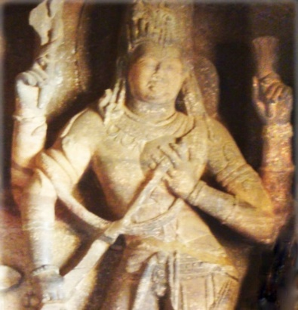
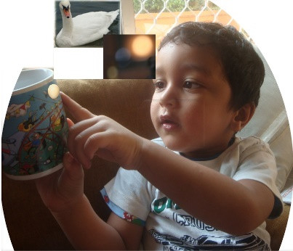
ATTITUDE FOR SUCCESS through SYNERGY
AI Chat GPT says,
“The book ‘Attitude for Success Through Synergy’ by P.K. Ratho is unique in its approach to combining attitudes for success with the principles of synergy, specifically focusing on integrating knowledge, skill, and attitude through the lens of yoga and self-discipline.
While there are many books on attitude, success, and synergy separately, Ratho's work is distinct in how it intertwines these elements with the practices and philosophies of yoga, aiming to cultivate a harmonious synergy of body and mind for personal and professional excellence.
This distinctive blend of traditional and modern concepts of success, along with practical applications in both personal development and teamwork, positions it uniquely among literature in the genre.”
Part 1: Developing Synergy of Body and Mind for Functional Perfection by following ‘Rules’ (Niyama). Improves IQ.
Part 2: Knowhow to Excel from Synergy of Team through Empathy (Yama).
Improves EQ.
Part 3: Knowhow to Excel from Synergy of Analytical and intuitive faculties thro’ control of mind (Samyama). Develops Genius.
Attitude for Success Part 2
Teambuilding to Excel
Through Synergy
Attitude for Success Part 3
Developing Genius
Through Synergy of
Analytical and Intuitive Faculties
(Right Brain) Visualises egg as potential
Swan and (Left Brain) analyses egg
for use

Slide 2

Problem: Education Develops Mere Awareness.
Solution: Increase Intelligence (IQ) / Personality
Successive Higher
Levels of Knowledge
Entrepreneur: Versatile and Intuitive
Management / Service Oriented: Works with people and is SMART
Insight
Application
Appreciation
Awareness
Intuitive: Knows ‘
how’ and ‘why’
(cause and effect):
Genius
Application
(I do, I know)
Appreciation / Skill by Training / Experiential Learning: Re-source –
Keen, perceptive
(I see, I believe)
Awareness of ‘what’: Re-cognise:
Text Education (I hear, I forget)

Slide 3
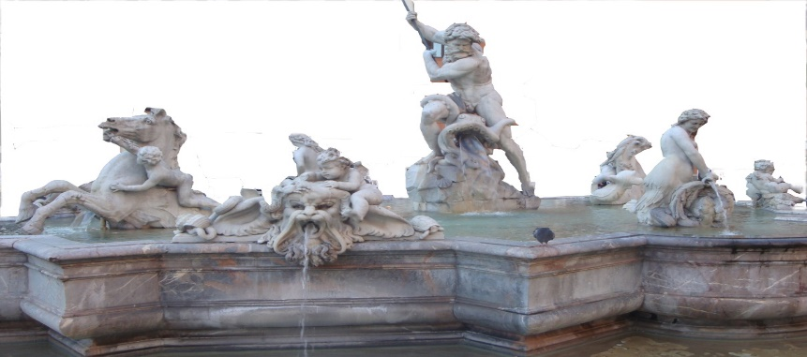
Part 1: Knowhow to Develop IQ
Ego Develops Ability (Quality)
Child ego (Tamas)
Natural: Happiness
Adapted: To succeed in society
Parent ego (Rajas)
Mother-like ‘Nurturing’
Father-like ‘Critical’
Adult ego (Sattwa) from
cause and effect
Synergy of Body and Mind from Functional Perfection
Plot the profile of motives and identify predominant motive; defines success
Plot profile of egos; defines ability
Plot the profiles of personality according to egos, concerns and profession
Develop belief of what leads to success
Indicate degrees of attitudes to be modified for synergy of body and mind to achieve success.

Slide 4


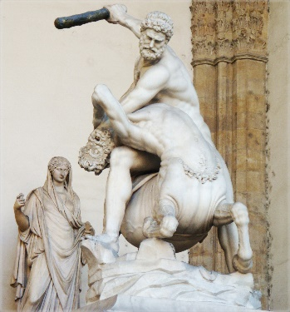
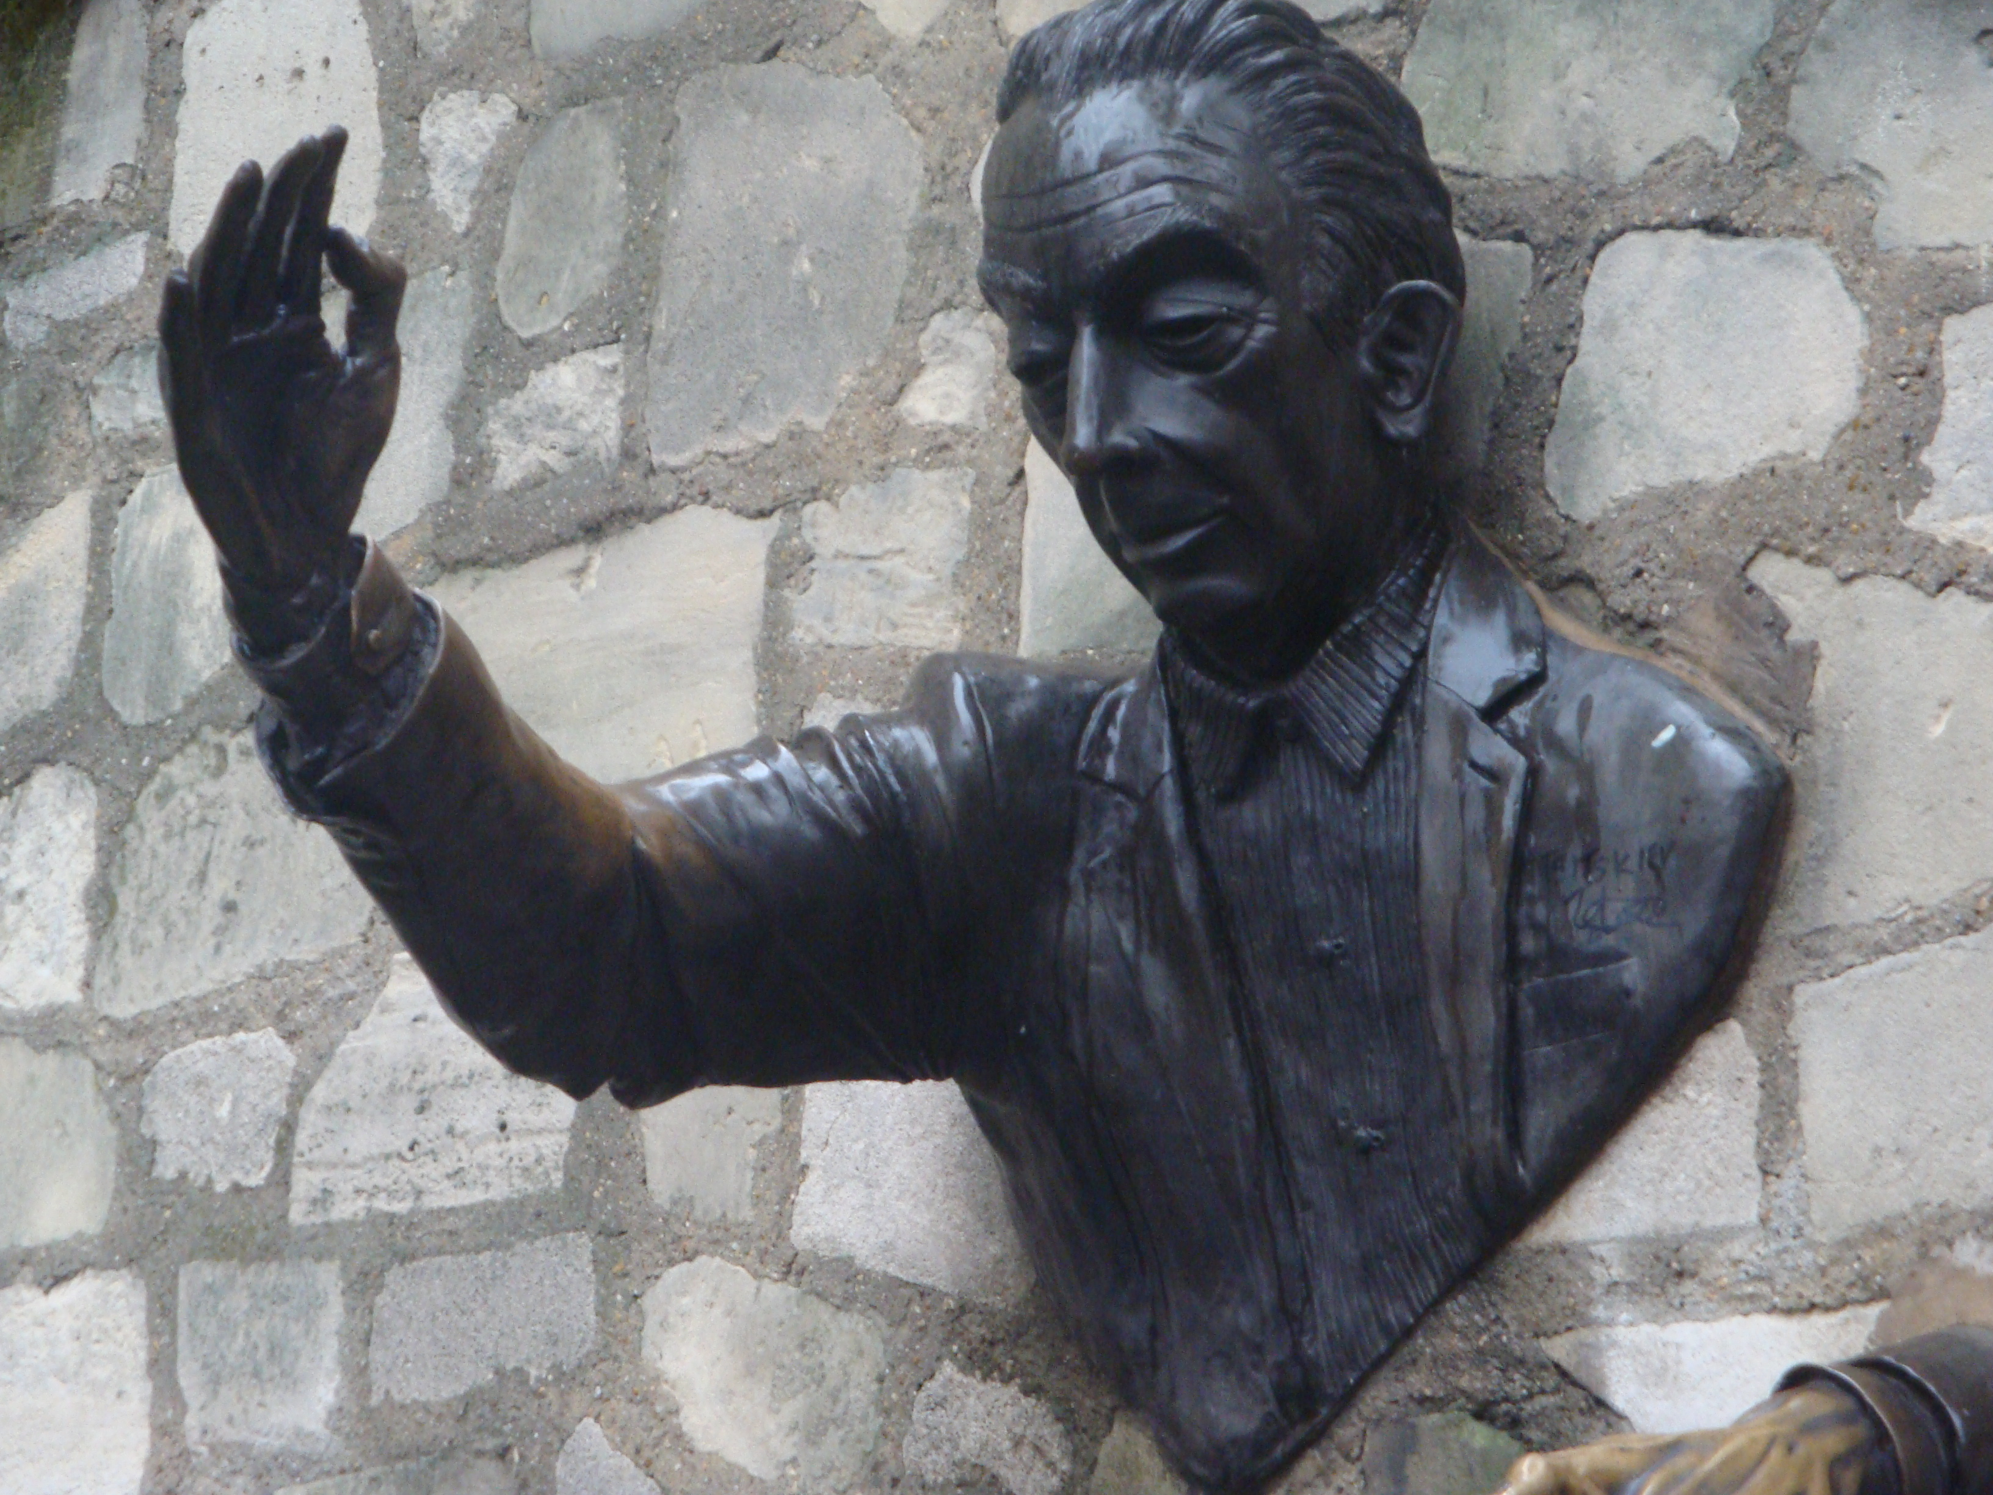
SYNERGY OF BODY AND MIND BY KRIYA YOGA
Healthy inputs Clean body, senses and mind |  | Functional perfection Versatile and genius (Pratibha)
Match strengths and opportunities to satisfy long-term need Find cause-and- effect. Get resources (content) |  | Happy by satisfying long-term need.
Be ambitious, proactive, enthusiastic, prompt, rule based and assertive Ensure right inputs, outputs, perception, effort and rest |  | Controls ego Synergy of body and mind.
Develop talent (skill) like Ideal through Study Training and Profession |  | Perceptive and intelligent Professionalism Risk-taking
Dedicate inputs and activities to Almighty (Pure Consciousness)

Slide 5
Software, Manual and Online Training
Input: Degrees of activities
‘Glossary’ in the manual / ‘Help’ menu of software ensures correct input of degrees of activities.
Manual (Book) gives knowhow
Software shows digitally the profiles of your personality and how to improve it
Training and practice ensure success
Model of Synergy for Success
Output:
Profile of Needs / Motives;
Profile of Egos / Attitudes
Professional Personality
Mental Blocks and their Removal
Activities to Develop Synergy of -
Body and Mind
Team
Analytical and Intuitive Faculties
.
Genius
Synergy for Success: Entrepreneur
Synergy of
Body and Mind
Synergy of
Team
Contact us: 1. www.buildbestvalues.com
2. P.K.Ratho, 0674-2951703 (M) 9437490303

